Slide 1
Network Support For Scalable And High-Performance Cloud Exchanges
Muhammad Haseeb, Jinkun Geng, Daniel Duclos-Cavalcanti, Xiyu Hao, Ulysses Butler, Radhika Mittal, Srinivas Narayana, Anirudh Sivaraman
New York University, Clockwork Inc., Technical University of Munich, Rutgers University, University of Illinois Urbana-Champaign

Slide 2
Primer On Financial Exchanges
Exchange Server
Market Participant 1
Market Participant 2
Market Participant 3

Slide 3
Primer On Financial Exchanges
Exchange Server
Market Participant 1
Market Participant 2
Market Participant 3

Slide 4
Primer On Financial Exchanges
Exchange Server
Market Participant 1
Market Participant 2
Market Participant 3

Slide 5
Primer On Financial Exchanges
Exchange Server
Market Participant 1
Market Participant 2
Market Participant 3

Slide 6
Primer On Financial Exchanges
Exchange Server
Market Participant 1
Market Participant 2
Market Participant 3

Slide 7
Primer On Financial Exchanges
Exchange Server
Market Participant 1
Market Participant 2
Market Participant 3

Slide 8
Primer On Financial Exchanges
Exchange Server
Market Participant 1
Market Participant 2
Market Participant 3

Slide 9
Primer On Financial Exchanges
Exchange Server
Market Participant 1
Market Participant 2
Market Participant 3

Slide 10
Primer On Financial Exchanges
Exchange Server
Market Participant 1
Market Participant 2
Market Participant 3

Slide 11
Primer On Financial Exchanges
Exchange Server
Market Participant 1
Market Participant 2
Market Participant 3

Slide 12
Primer On Financial Exchanges
Exchange Server
Market Participant 1
Market Participant 2
Market Participant 3

Slide 13
Primer On Financial Exchanges
Exchange Server
Which participant gets to buy or sell, depends on who asked first!
Participants may compete on how fast they can respond to any information from the exchange
Notes:
Price time priority algorithm

Slide 14
Primer On Financial Exchanges
Space + Cost!
Traditional exchanges built in private data centers or colocation facilities!
Exchange Server
Which participant gets to buy or sell, depends on who asked first!
Competition Among MPs
Participants may compete on how fast they can respond to any information from the exchange
Notes:
Price time priority algorithm

Slide 15
Primer On Financial Exchanges
Exchange Server
order closer to mid price → Immediate execution/match
order away from mid price → potential execution/match in future
Position in the queue/price level matters!
Notes:
Price time priority algorithm

Slide 16
Primer On Financial Exchanges
Traditional exchanges built in private data centers or colocation facilities!
Exchange Server
order closer to mid price → Immediate execution/match
Competition Among MPs
order away from mid price → potential execution/match in future
Position in the queue/price level matters!

Slide 17
Can we use the public cloud to build and scale
financial exchanges?

Slide 18
Benefits of Public Cloud for Financial Exchanges
Reducing constraints of physical space around the exchange server
Unprecedented scale – 1000s of traders can be supported
Low barriers to entry for launching new global markets
Various analytics/ML services residing nearby
And typical benefits of cloud: flexible resource allocation, reduced cost, offloading management etc.
There will be trade-offs.
Latencies will be higher.
Fairness guarantees will be coarser.

Slide 19
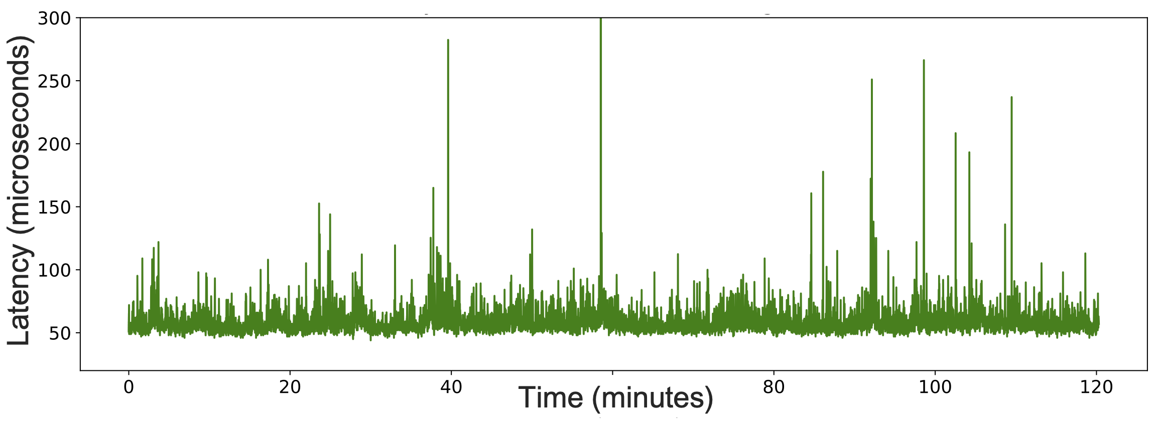
Public Cloud Exhibits High Latency & Variance
Latency varies temporally
Latency varies spatially – across multiple clients
Unfit for fair competition
Onyx: mechanisms to achieve fairness + high performance at scale
Notes:
Will replace png with pdf, somehow adding pdf is making it too heavy for powerpoint to handle.

Slide 20
economy
scalability
10,000 MPs
Web APIs
$16/month/MP
1000 MPs
Onyx
(this work)
$60K/month/MP
100 MPs
On-Prem
~100 ms
± 10 ms
< 100 us
± 1 us
± 10 ns
< 1 us
performance
fairness
Away from center = better

Slide 21
Onyx: Scalable Cloud Financial Exchange
An order submission service which effectively handles bursty traffic while maintaining fairness of competition among the participants
Prototyped on AWS and GCP
Multicast service that disseminates market data to 1000 participants, each receiving a message within 1-microsecond of each other

Slide 22

Onyx
Fairness definitions and relaxation
Scalable outbound fairness
Scalable inbound fairness
A scheduling policy to gracefully handle bursts
Definitions | Outbound | Inbound

Slide 23
Onyx
Fairness definitions and relaxation
Scalable outbound fairness
Scalable inbound fairness
A scheduling policy to gracefully handle bursts
Definitions | Outbound | Inbound

Slide 24
Fairness¹
[1] CloudEx: A Fair-Access Financial Exchange in the Cloud
Outbound Fairness
Inbound Fairness
Definitions | Outbound | Inbound

Slide 25
Fairness¹
[1] CloudEx: A Fair-Access Financial Exchange in the Cloud
Outbound Fairness
Exchange Server
Inbound Fairness
MP1
MP2
MP3
Definitions | Outbound | Inbound

Slide 26
Fairness¹
[1] CloudEx: A Fair-Access Financial Exchange in the Cloud
Outbound Fairness
Exchange Server
Inbound Fairness
MP1
MP2
MP3
Definitions | Outbound | Inbound

Slide 27
Fairness¹
[1] CloudEx: A Fair-Access Financial Exchange in the Cloud
Outbound Fairness
Exchange Server
Inbound Fairness
MP1
MP2
MP3
Definitions | Outbound | Inbound

Slide 28
Fairness¹
[1] CloudEx: A Fair-Access Financial Exchange in the Cloud
Outbound Fairness
Exchange Server
Difference in data reception time for any two participants should be 0
t1
t2
t3
Inbound Fairness
MP1
MP2
MP3
Definitions | Outbound | Inbound

Slide 29
Fairness¹
[1] CloudEx: A Fair-Access Financial Exchange in the Cloud
Exchange Server
Outbound Fairness
Exchange Server
Difference in data reception time for any two participants should be 0
MP1
MP2
MP3
t1
t2
t3
Inbound Fairness
MP1
MP2
MP3
Definitions | Outbound | Inbound

Slide 30
Fairness¹
[1] CloudEx: A Fair-Access Financial Exchange in the Cloud
Exchange Server
Outbound Fairness
Exchange Server
Difference in data reception time for any two participants should be 0
MP1
MP2
MP3
t1
t2
t3
Inbound Fairness
MP1
MP2
MP3
Definitions | Outbound | Inbound

Slide 31
Fairness¹
[1] CloudEx: A Fair-Access Financial Exchange in the Cloud
Exchange Server
Outbound Fairness
Exchange Server
Difference in data reception time for any two participants should be 0
MP1
MP2
MP3
t1
t2
t3
Inbound Fairness
MP1
MP2
MP3
Definitions | Outbound | Inbound

Slide 32
Fairness¹
[1] CloudEx: A Fair-Access Financial Exchange in the Cloud
Exchange Server
Outbound Fairness
Exchange Server
Difference in data reception time for any two participants should be 0
MP1
MP2
MP3
t1
t2
t3
Inbound Fairness
MP1
MP2
MP3
Definitions | Outbound | Inbound

Slide 33
Fairness¹
[1] CloudEx: A Fair-Access Financial Exchange in the Cloud
Exchange Server
Outbound Fairness
Orders should be seen by the exchange in the generation order
Exchange Server
Difference in data reception time for any two participants should be 0
MP1
MP2
MP3
t1
t2
t3
Inbound Fairness
MP1
MP2
MP3
Definitions | Outbound | Inbound

Slide 34
Fairness¹
[1] CloudEx: A Fair-Access Financial Exchange in the Cloud
Outbound Fairness
Difference in data reception time for any two participants should be 0
Orders should be seen by the exchange in the generation order
Inbound Fairness
Definitions | Outbound | Inbound

Slide 35
Fairness In Practice
[1] CloudEx: A Fair-Access Financial Exchange in the Cloud
Outbound Fairness
Difference in data reception time for any two participants should be 0
Orders should be seen by the exchange in the generation order
Inbound Fairness
Definitions | Outbound | Inbound

Slide 36
Fairness In Practice
[1] CloudEx: A Fair-Access Financial Exchange in the Cloud
Outbound Fairness
Difference in data reception time for any two participants should be ~0
Orders should be seen by the exchange in the generation order
Inbound Fairness
Definitions | Outbound | Inbound

Slide 37
Fairness In Practice
[1] CloudEx: A Fair-Access Financial Exchange in the Cloud
Outbound Fairness
Difference in data reception time for any two participants should be ~0
Orders should be seen by the exchange in the timestamped generation order
Inbound Fairness
Achieving fairness while being performant at scale is our goal.
Definitions | Outbound | Inbound

Slide 38
Fairness In Practice
[1] CloudEx: A Fair-Access Financial Exchange in the Cloud
Outbound Fairness
Difference in data reception time for any two participants should be ~0
We target 1000 market participants (MPs). Each MP is a separate VM.
Orders should be seen by the exchange in the timestamped generation order
Inbound Fairness
Achieving fairness while being performant at scale is our goal.
Definitions | Outbound | Inbound

Slide 39
Scalable Outbound Fairness
Fairness achieved by a simple “Hold-and-release” primitive.
Not scalable w.r.t the number of receivers/participants.
Definitions | Outbound | Inbound

Slide 40

Hold-and-release
S
Senders and receivers synchronized to the same clock
Sender attaches deadline to message
Deadline: 0009 | …
0000
0001
0002
0003
0004
0005
0006
0007
0008
0009
Sender multicasts message to all receivers
Deadline: 0009 | …
Deadline: 0009 | …
Deadline: 0009 | …
Deadline: 0009 | …
Deadline: 0009 | …
Messages arrive at unpredictable times
R1
R2
R3
R4
. . . . . . .
Rn
0000
0001
0002
0003
0004
0005
0006
0007
0008
0009
0000
0001
0002
0003
0004
0005
0006
0007
0008
0009
0000
0001
0002
0003
0004
0005
0006
0007
0008
0009
0000
0001
0002
0003
0004
0005
0006
0007
0008
0000
0009
0001
0002
0003
0004
0005
0006
0007
0008
0009
Receiver processes message when deadline is reached on receiver clock
Definitions | Outbound | Inbound
Notes:
We cannot control the arrival time of the messages at each receiver. The messages can arrive at the receivers at unpredictable times.
But since the receivers are sharing the same timeline,
we can make each receiver to hold the messages and process the message at the same time

Slide 41

Scalable Outbound Fairness
Fairness achieved by a simple “hold-and-release” primitive.
We scale it much further by proposing an efficient market data multicast mechanism.
A tree of proxy nodes is utilized that helps scale multicast.
Latency
Fairness
Exchange
Latency Spikes On Links
Proxy node’s performance variation
Receiver VMs’ performance variation
Round Robin Packet Spraying
Proxy Hedging i.e., multiple (H) parents
Two VMs per trader
Definitions | Outbound | Inbound

Slide 42
Scalable Outbound Fairness
Achieved by a simple “hold-and-release” primitive.
We scale it much further by proposing an efficient market data multicast mechanism.
A tree of proxy nodes is utilized that helps scale multicast.
Latency Spikes On Links
Proxy VM’s performance variation
Receiver VMs’ performance variation
Round Robin Packet Spraying
Proxy Hedging i.e., multiple (H) parents
Two VMs per trader

Slide 43
Inbound Fairness
-- Strawman (CloudEx)
Clocks are synchronized for all clients
Clients attach timestamps to messages before sending them to the exchange
Exchange receives messages, sorts them by their timestamps and processes them
Each message received by the exchange is only processed once it has been a threshold amount of time old to account for network reordering
Problems:
Fairness violation under latency spikes
Does not scale well

Slide 44
Scalable Inbound Fairness
Sequencer
Scheduling Policy
Definitions | Outbound | Inbound

Slide 45
Scalable Inbound Fairness
Sequencer
Scheduling Policy
Sequencer
LOQ
Definitions | Outbound | Inbound

Slide 46
Scalable Inbound Fairness
Sequencer
Scheduling Policy
Sequencer
Definitions | Outbound | Inbound
LOQ

Slide 47


A sequencer
Exchange Server
Guarantees that orders are seen by the exchange in non-decreasing order of their (generation) timestamps
Assumes clock synchronization
Strawman: Wait a fixed delay before releasing time-ordered messages to Exchange Server
Latency
Fairness
Participants
Definitions | Outbound | Inbound: Sequencer + LOQ

Slide 48





A sequencer
Can use knowledge of MPs!
Exchange Server
Clients attach message generation timestamps to outgoing messages
Sequencer waits for at least one message from each client
Clients/Participants
2
1
3
Definitions | Outbound | Inbound: Sequencer + LOQ

Slide 49
A sequencer
Can use knowledge of MPs!
Exchange Server
Clients attach message generation timestamps to outgoing messages
Sequencer waits for at least one message from each client
2
Clients/Participants
1
3
Definitions | Outbound | Inbound: Sequencer + LOQ

Slide 50
A sequencer
Can use knowledge of MPs!
Exchange Server
Clients attach message generation timestamps to outgoing messages
Sequencer waits for at least one message from each client
2
1
Clients/Participants
3
Definitions | Outbound | Inbound: Sequencer + LOQ

Slide 51
A sequencer
Can use knowledge of MPs!
Exchange Server
Clients attach message generation timestamps to outgoing messages
Sequencer waits for at least one message from each client
It releases the smallest ts’ message and waits again
3
2
1
Clients/Participants
Definitions | Outbound | Inbound: Sequencer + LOQ
Notes:
Results all for GCP, except AWS TGW >50 % lower latency than the latency provided by AWS TGW

Slide 52
A sequencer
Can use knowledge of MPs!
Exchange Server
Clients attach message generation timestamps to outgoing messages
Sequencer waits for at least one message from each client
1
It releases the smallest ts’ message and waits again
3
2
Clients/Participants
4
Definitions | Outbound | Inbound: Sequencer + LOQ

Slide 53
A sequencer
Can use knowledge of MPs!
Exchange Server
Clients attach message generation timestamps to outgoing messages
Sequencer waits for at least one message from each client
1
It releases the smallest ts’ message and waits again
4
3
2
Clients/Participants
Definitions | Outbound | Inbound: Sequencer + LOQ

Slide 54
A sequencer
Can use knowledge of MPs!
Exchange Server
Clients attach message generation timestamps to outgoing messages
Sequencer waits for at least one message from each client
2
1
It releases the smallest ts’ message and waits again
4
3
Clients/Participants
Definitions | Outbound | Inbound: Sequencer + LOQ

Slide 55
A sequencer
Drawback: liveness (progress) may halt under client failures
Safety (fairness) is guaranteed if clocks are perfectly synchronized
In practice, we ensure that clock synchronization accuracy is sufficiently high compared to the time granularity of interest.
Definitions | Outbound | Inbound: Sequencer + LOQ

Slide 56
Incast Congestion
As the number of clients increase, the incast congestion at the exchange occurs.
We see the opportunity to reuse the multicast tree in the reverse direction to reduce burstiness behavior at the ingress of the exchange.
Clients get partitioned into groups where each leaf proxy node handles a group of clients.
Reduced fan-in at the exchange, leads to lower packet drops.
Enables scheduling of packets at the tree nodes (virtual network nodes) as it moves queues from the exchange ingress to the tree nodes
Definitions | Outbound | Inbound: Sequencer + LOQ

Slide 57
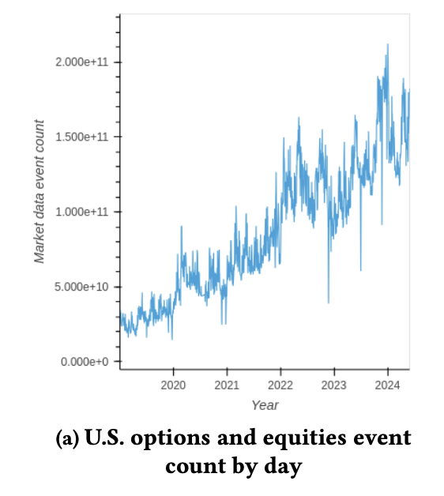
Limit Order Queue
Network Design Considerations for Trading Systems, Myers et al, HotNets24
Bursty orders
Exchange ingress BW limited
Definitions | Outbound | Inbound: Sequencer + LOQ

Slide 58
Limit Order Queue
LOQ: A Domain-Specific Scheduling Policy
During bursty market activity, the exchange server may be overwhelmed.
Schedules order in a way to avoid idling the matching engine, using the knowledge that orders are matched by price time priority algorithm
$1
$4
$5
$2
Naively doing such prioritization will not preserve inbound fairness.
Definitions | Outbound | Inbound: Sequencer + LOQ
Notes:
If queues are filled with older and newer orders and we simply prioritize the orders with price closer to the mid-price, it may violate fairness. Perhaps another order in some other queue would have moved mid-price in favor of the order being de-prioritized if everything was FIFO.

Slide 59
Limit Order Queue Preserves Fairness
Exchange
FIFO Fabric
MP1
MP2
MP3
MPn
Definitions | Outbound | Inbound: Sequencer + LOQ
Notes:
Not all orders match immidiately

Slide 60
Limit Order Queue Preserves Fairness
Exchange
FIFO Fabric
MP1
MP2
MP3
MPn
Definitions | Outbound | Inbound: Sequencer + LOQ
Notes:
Not all orders match immidiately

Slide 61
Limit Order Queue Preserves Fairness
Exchange
I_{FIFO}
FIFO Fabric
MP1
MP2
MP3
MPn
Definitions | Outbound | Inbound: Sequencer + LOQ
Notes:
Input sequence

Slide 62
Limit Order Queue Preserves Fairness
S_{FIFO}
Exchange
I_{FIFO}
FIFO Fabric
MP1
MP2
MP3
MPn
Definitions | Outbound | Inbound: Sequencer + LOQ
Notes:
Not all orders match immidiately

Slide 63
Limit Order Queue Preserves Fairness
S_{FIFO}
Exchange
Exchange
I_{FIFO}
FIFO Fabric
LOQ Fabric
MP1
MP2
MP3
MPn
MP1
MP2
MP3
MPn
Definitions | Outbound | Inbound: Sequencer + LOQ
Notes:
Not all orders match immidiately

Slide 64
Limit Order Queue Preserves Fairness
S_{FIFO}
Exchange
Exchange
I_{FIFO}
FIFO Fabric
LOQ Fabric
MP1
MP2
MP3
MPn
MP1
MP2
MP3
MPn
Definitions | Outbound | Inbound: Sequencer + LOQ
Notes:
Not all orders match immidiately

Slide 65
Limit Order Queue Preserves Fairness
S_{FIFO}
Exchange
Exchange
I_{FIFO}
FIFO Fabric
LOQ Fabric
MP1
MP2
MP3
MPn
MP1
MP2
MP3
MPn
Definitions | Outbound | Inbound: Sequencer + LOQ
Notes:
Not all orders match immidiately

Slide 66
Limit Order Queue Preserves Fairness
S_{FIFO}
Exchange
Exchange
I_{FIFO}
I_{LOQ}
FIFO Fabric
LOQ Fabric
MP1
MP2
MP3
MPn
MP1
MP2
MP3
MPn
Definitions | Outbound | Inbound: Sequencer + LOQ
Notes:
Not all orders match immidiately

Slide 67
Limit Order Queue Preserves Fairness
S_{FIFO}
S_{LOQ}
Exchange
Exchange
I_{FIFO}
I_{LOQ}
FIFO Fabric
LOQ Fabric
MP1
MP2
MP3
MPn
MP1
MP2
MP3
MPn
Definitions | Outbound | Inbound: Sequencer + LOQ
Notes:
Not all orders match immidiately

Slide 68
Limit Order Queue Preserves Fairness
Exchange
Exchange
I_{FIFO}
I_{LOQ}
S_{FIFO}
=
S_{LOQ}
FIFO Fabric
LOQ Fabric
MP1
MP2
MP3
MPn
MP1
MP2
MP3
MPn
Definitions | Outbound | Inbound: Sequencer + LOQ
Notes:
Details in the paper how the function is designed to preserve the fairness while increasing performance

Slide 69
Limit Order Queue Preserves Fairness
Exchange
Exchange
S_{FIFO}
=
S_{LOQ}
FIFO Fabric
LOQ Fabric
I_{FIFO}
≠
I_{LOQ}
MP1
MP2
MP3
MPn
MP1
MP2
MP3
MPn
Definitions | Outbound | Inbound: Sequencer + LOQ
Notes:
Details in the paper how the function is designed to preserve the fairness while increasing performance

Slide 70
Limit Order Queue Preserves Fairness
Preserves Fairness
Exchange
Exchange
S_{FIFO}
=
S_{LOQ}
FIFO Fabric
LOQ Fabric
I_{FIFO}
≠
I_{LOQ}
MP1
MP2
MP3
MPn
MP1
MP2
MP3
MPn
Definitions | Outbound | Inbound: Sequencer + LOQ
Notes:
Details in the paper how the function is designed to preserve the fairness while increasing performance

Slide 71
Limit Order Queue Preserves Fairness
Key Idea:
Separate critical and non-critical orders using the mid-price
Preserves Fairness
Exchange
Exchange
S_{FIFO}
=
S_{LOQ}
FIFO Fabric
LOQ Fabric
I_{FIFO}
≠
I_{LOQ}
Room for improving performance with scheduling
MP1
MP2
MP3
MPn
MP1
MP2
MP3
MPn
Definitions | Outbound | Inbound: Sequencer + LOQ
Notes:
Details in the paper how the function is designed to preserve the fairness while increasing performance

Slide 72
Evaluation

Slide 73
Key Questions
Does Onyx deliver a low overall multicast latency?
Does Onyx provide outbound and inbound fairness?
Does Onyx scale? (~1000 market participants)

Slide 74
Multicast Service

Slide 75
Multicast Service

Slide 76
Delivery Fairness

Slide 77
Delivery Fairness

Slide 78
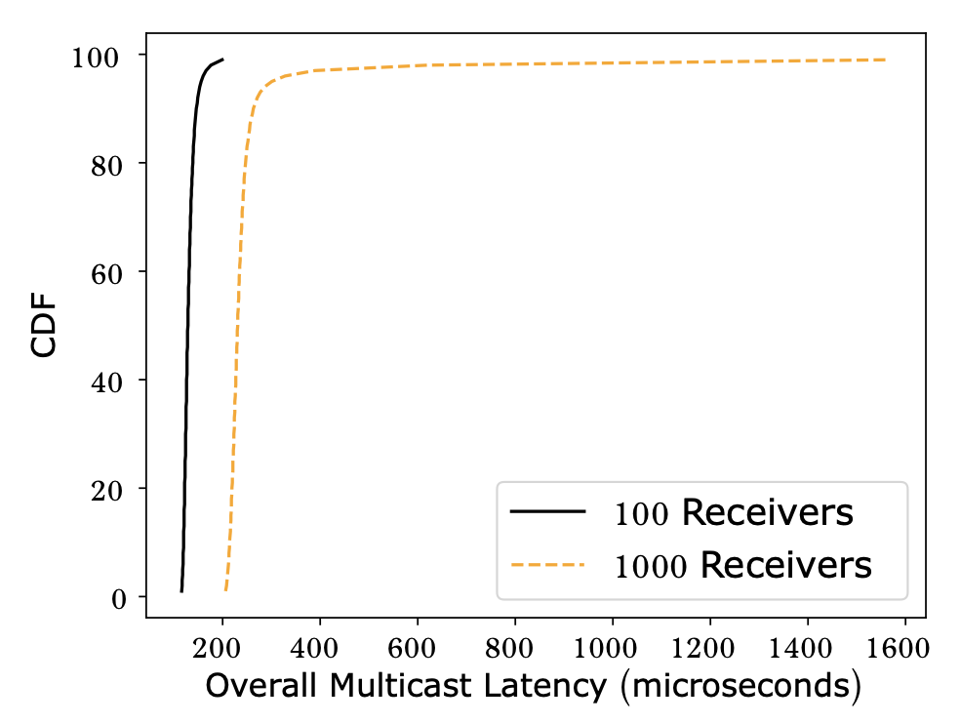
Scale

Slide 79
Limit Order Queue Gracefully Handles Bursts
Load generation stops here
Notes:
Order matched per second

Slide 80
Order Submission Service
Load generation stops here

Slide 81
Order Submission Service
LOQ
FIFO

Slide 82
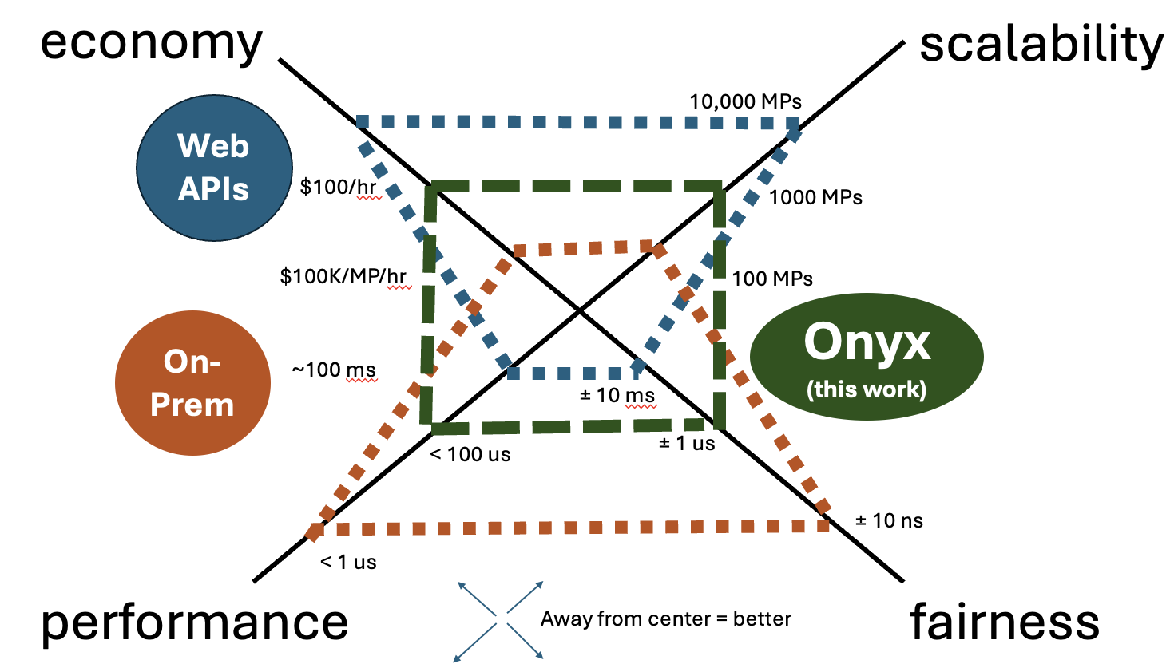
Concluding Remarks
Cloud financial exchanges can be realized by developing new primitives, without specialized infrastructure
Some fairness/performance guarantees need to be accordingly relaxed
Such exchanges present a new operating point in the cost-performance curve
Application-specific scheduling can have a significant beneficial impact
Notes:
Not all orders match immidiately

Slide 83
Incast Congestion
As the number of clients increase, the incast congestion at the exchange occurs.
We see the opportunity to reuse the multicast tree in the reverse direction to reduce burstiness behavior at the ingress of the exchange.
Clients get partitioned into groups where each leaf proxy node handles a group of clients.
Reduced fan-in at the exchange, leads to lower packet drops.
One sequencer instance runs at each tree node to achieve inbound fairness.
Enables scheduling of packets at the tree nodes (virtual network nodes) as it moves queues from the exchange ingress to the tree nodes

Slide 84
Limit Order Queue
Rank: < mid-price ID, criticality, timestamp >
Each LOQ lexicographically sorts the received orders based on the above tuple
mid-price ID is a global variable at each MP
Increments each time the mid-price changes
Assumption: each mid-price change is observed by all MPs at the same time
Criticality is a Boolean variable, 0 if an order is critical, 1 otherwise
If an order has a price close to the mid-price, then it is critical.
How close it needs to be considered critical? Defined by “Action Window (w)”. We skip the details.
Timestamp is attached to each order by a trader.
Assume that the MPs cannot lie about the timestamps. Details in the paper.
The above priority scheduling preserves fairness while enhancing performance
Argument in the paper!
Notes:
Not all orders match immidiately

Slide 85
How < mid-price ID, criticality, timestamp > ensures S_{FIFO} = S_{LOQ}?
Consider a static mid-price.
Consider no bid is generated with price more than the mid-price.
Consider no ask is generated with price less than the mid-price.
In such a scenario, all orders that will get matched will be the ones with the price equal to the mid-price.
All such orders are sorted by timestamps by each LOQ and the sequencer at the matching engine ensures that it “merge-sorts” the messages from individual LOQs before feeding them to the ME.
This behavior is equivalent to not having LOQ so S_{FIFO} = S_{LOQ}
More details in the paper that expand on:
Having mid-price ID as the first element in the ranking tuple ensures that S_{FIFO} = S_{LOQ} even when the mid-price changes.
And our way of assigning criticality ensures that S_{FIFO} = S_{LOQ} even when bids and asks can have prices more or less than the mid-price respectively.
Notes:
Not all orders match immidiately

